Slide 1
Secure Data Hiding In Image Using Steganography
Presented By
Student Name : MEGAVARSHINI A
College Name & Department : SNS COLLEGE OF TECHNOLOGY & Comuter Science And Engineering

Slide 2
OUTLINE
Problem Statement
Technology used
Wow factor
End users
Result
Conclusion
Git-hub Link
Future scope

Slide 3
Problem Statement
This project focuses on image steganography, where a hidden message is embedded into an image using pixel manipulation. The goal is to develop a Python-based encoding and decoding system that ensures secure communication. The encoded image should retain its original format while carrying hidden data, making it undetectable to unauthorized users.

Slide 4
Technology used
This project is developed using Python, a versatile programming language widely used for cybersecurity and cryptography applications. The key library utilized is Pillow (PIL), which provides image processing capabilities for embedding and extracting hidden data within images. Additionally, the OS module is used for handling file paths and directories, ensuring proper file management. The platform for execution is Windows OS, with Python 3.x installed for running the steganography-based secure data hiding program.

Slide 5
Wow factors
Unlike traditional steganography, this project enhances security and efficiency by integrating encryption before embedding the message, ensuring double-layer protection. It also supports adaptive encoding, where only specific image regions are modified, minimizing visual distortion. Additionally, a robust extraction mechanism is implemented to accurately retrieve hidden data, even if minor alterations occur. Future enhancements include AI-based steganalysis resistance to detect and counteract steganalysis attacks, making the system highly secure and innovative.

Slide 6
End users
Cybersecurity Professionals – To securely transmit sensitive information without detection.
Government & Defense Organizations – For covert communication and securing classified data.
Journalists & Whistleblowers – To share confidential information while avoiding surveillance.
Businesses & Corporations – To protect intellectual property and secure internal communications.
Individuals Concerned About Privacy – To safeguard personal data from cyber threats.

Slide 7

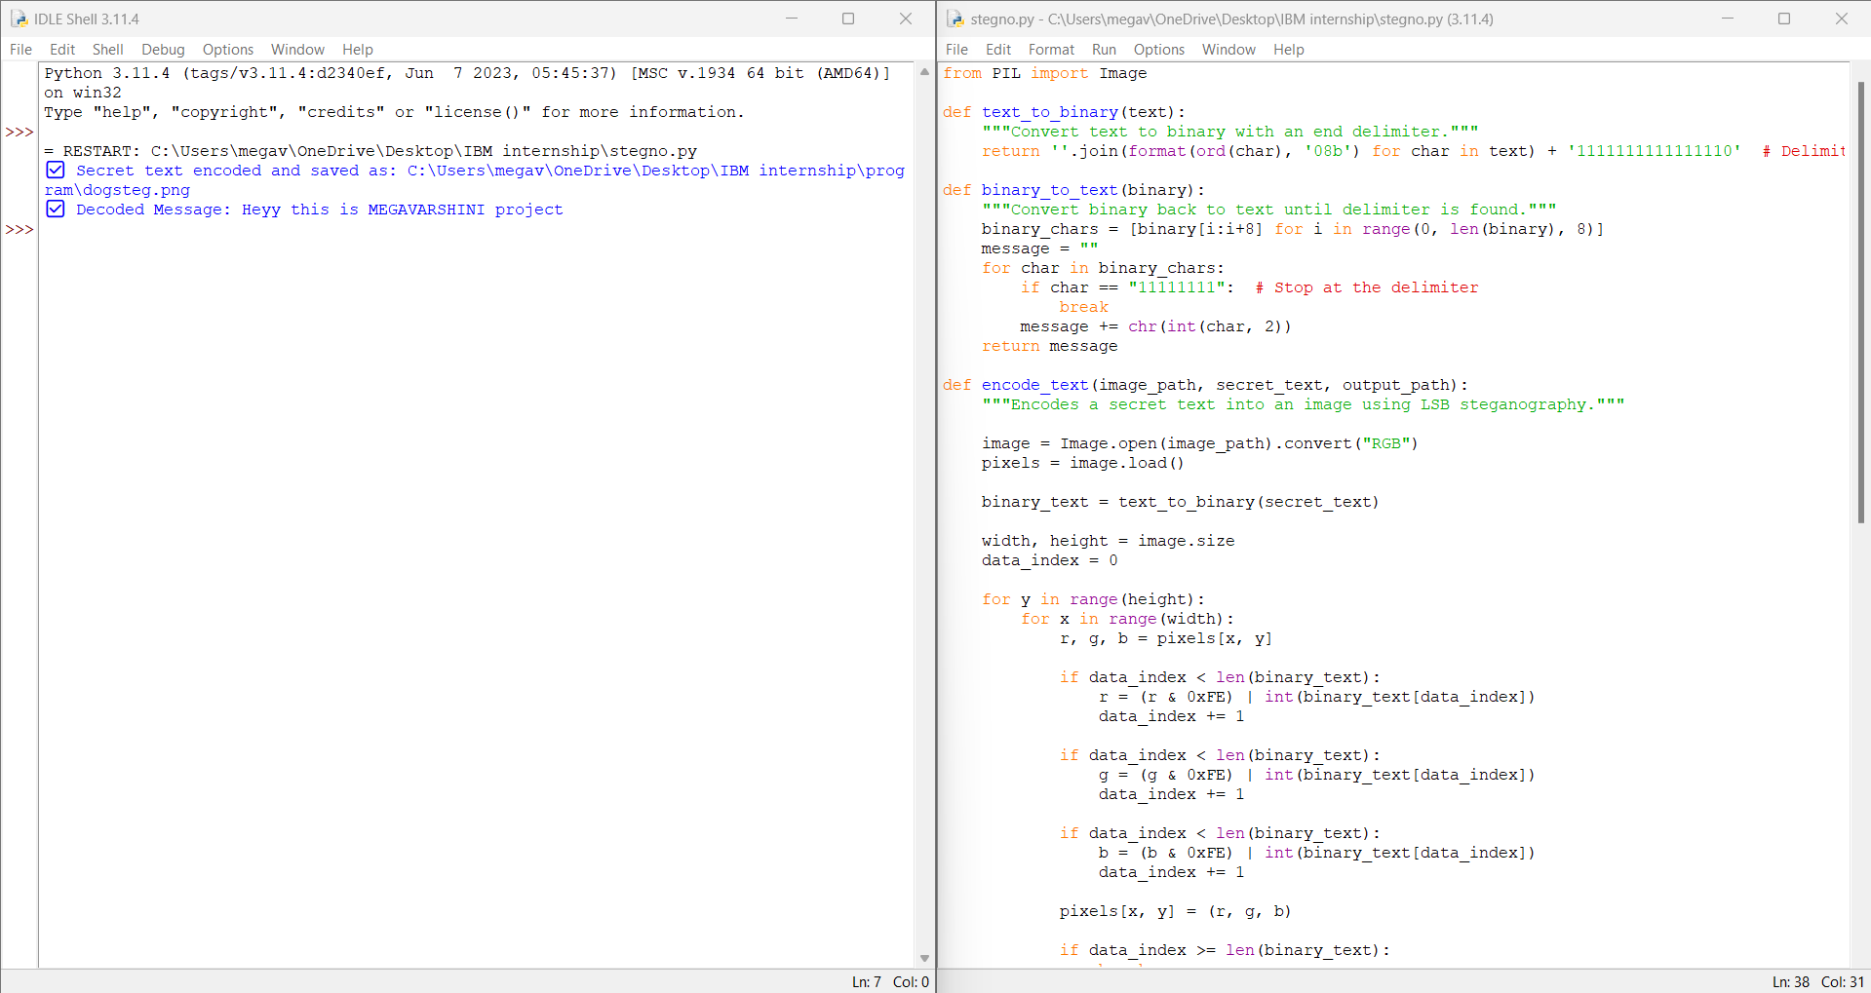

Results
Original Image
Text Hided
Image
Program & output

Slide 8
Conclusion
This project addresses the growing need for secure data transmission by implementing image steganography, ensuring that sensitive information remains hidden within digital images. By leveraging encryption and pixel manipulation techniques, the system enhances data security and confidentiality while maintaining the original image's integrity. With applications in cybersecurity, defense, journalism, and corporate communication, this solution provides a robust, undetectable, and efficient method for secure information exchange. Future enhancements can include AI-based detection resistance and multi-layer encryption, further strengthening the system's security.

Slide 9
GitHub Link
Github Link :
https://github.com/MEGAVARSHINI2004/Aicteinternship.git

Slide 10
Future scope(optional)
AI-Powered Steganalysis Resistance – Implement machine learning techniques to evade detection by advanced steganalysis tools.
Multi-Layer Security – Integrate additional encryption algorithms before embedding data to enhance security.
Support for Multiple File Formats – Extend the project to hide not just text but also files like PDFs, audio, or videos within images.
Cloud-Based Steganography – Develop a web-based or cloud-integrated system for remote secure data hiding and retrieval.
Real-Time Communication Integration – Implement steganography in messaging apps for secure and private communication.

Slide 11
THANK YOU

